Slide 1
Perform data engineering with Azure Synapse Apache Spark Pools
Notes:
Before delivering this presentation, review the associated modules on Microsoft Learn (https://aka.ms/mslearn-spark) and complete the exercises.
Before starting your delivery, prepare a lab environment for the first demonstration by running the setup script.

Slide 2



Agenda
Analyze data with Apache Spark in Azure Synapse Analytics
Transform data with Apache Spark in Azure Synapse Analytics
Use Delta Lake in Azure Synapse Analytics

Slide 3
Analyze data with Apache Spark in Azure Synapse Analytics

Slide 4
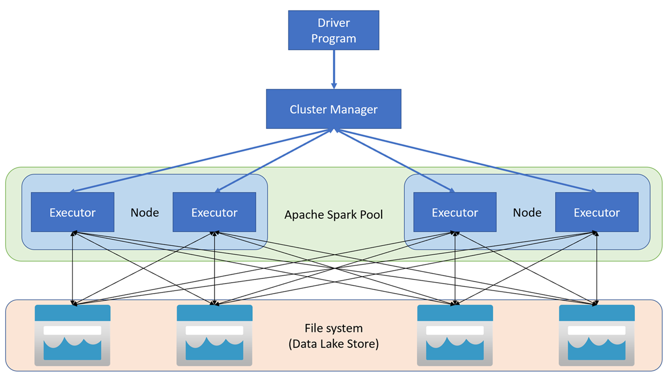
Get to know Apache Spark
Distributed data processing framework
Code in multiple languages
Driver program uses SparkContext to coordinate processing across multiple executors on worker nodes
Executors run in parallel to process data in a distributed file system
Spark pools in Azure Synapse Analytics
Named serverless cluster that auto-starts and stops - option to auto-scale
Specific Spark Runtime version
Notes:
Ask students if they have used Spark on other platform, such as Azure HDInsight or Azure Databricks. The Spark implementation in Azure Synapse Analytics is based on the same Open Source Apache Spark platform, hosted in a pool (cluster) of driver and worker nodes in a Synapse Analytics workspace.
For students who aren’t familiar with Spark, the core concept to understand is the distribution of data processing cross multiple worker nodes. The workers each work on their subset of the overall processing task in parallel, enabling massive scalability across huge volumes of data.
Point out that each Spark pool is configured to use a specific Spark Runtime – this is essentially a “version” for the package of Spark and related technologies installed in the pool. In many cases, you need to choose an appropriate Spark Runtime for the specific version of Spark, Python, or other packages that your processing workload depends on.

Slide 5
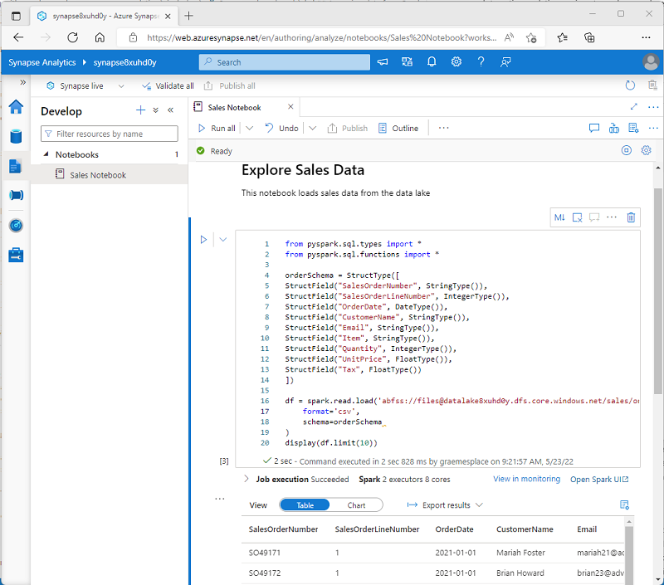
Use Spark in Azure Synapse Analytics
Integrated notebooks
Syntax highlighting and error support
Code auto-completion​
Interactive data visualizations
Ability to export results
Work with data in multiple stores
Primary workspace data lake
Linked service storage
Dedicated or serverless SQL pool
Azure SQL or SQL Server database
Azure Cosmos DB
Azure Data Explorer Kusto database
External Hive metastore
Notes:
The primary way that data engineers (and data analysts and data scientists) work with Spark is by using Notebooks containing a mix of code and notes in Markdown. Azure Synapse Studio includes native support for notebooks based on the interactive Python notebook (ipynb) format popularized in tools such as Jupyter. Despite the name of the format, Spark notebooks can include code written in multiple languages, including Scala and SQL as well as Python.
When using Spark in Azure Synapse Analytics, you can work with data in multiple stores. Most commonly, you’ll process data files in a data lake – typically the default data lake for the workspace, which is hosted in Azure Data Lake Storage Gen2; but you can use various linked services and connectors to work with data in other sources.

Slide 6
Analyze data with Spark
Explore data with dataframes
%%pyspark
# Load data
df=spark.read.load("/data/products.csv", format="csv", header=True)
# Manipulate dataframe
counts_df = df.select("ProductID", "Category").groupBy("Category").count()
# Display dataframe
display(counts_df)
Category | count
Headsets | 3
Wheels | 14
Mountain Bikes | 32
... | ...
Notes:
The %pyspark “magic” at the beginning of the code instructs Spark to treat the following code as Python. You could also use %spark to indicate that the code cell contains Scala code.
Dataframes are not the only way to work with data in Spark, but they’re the most common. Other data object types include resilient distributed dataset (RDD), which are the core native building block for data structures in Spark, and Datasets, which are essentially strongly-typed dataframes. Dataframes are provided on Spark via the SparkSQL library and are functionally very similar to Pandas dataframes that are commonly used in Python (with which some students may be familiar).
The code sample on the slide shows how to load a dataframe with data from a CSV file (you can also load data from other formats, including Parquet) and how to use some of its built-in methods (specifically select and groupBy) and functions (count) to manipulate data. For details about these and other dataframe methods and functions, see the Spark Dataframe API documentation at https://spark.apache.org/docs/latest/api/python/reference/pyspark.sql/dataframe.html.

Slide 7
Analyze data with Spark
Using SQL expressions in Spark
%%pyspark
# Create a table in the metastore
df.createOrReplaceTempView("products")
# Use spark.sql method for inline SQL queries that return a dataframe
bikes_df = spark.sql("SELECT ProductID, ProductName, ListPrice \
FROM products \
WHERE Category IN ('Mountain Bikes', 'Road Bikes')")
display(bikes_df)
%sql
-- Use SQL to query tables in the metastore
SELECT Category, COUNT(ProductID) AS ProductCount
FROM products
GROUP BY Category
ORDER BY Category
Notes:
In addition to providing the dataframe object, the SparkSQl library provides support for SQL syntax, either via the spark.sql method to return a dataframe or in standalone SQL code.
To understand what’s going on in the code examples, students need to be aware of the existence of the Spark “metastore”, which you can think of as being a relational database layer in which tables and views are defined. The data itself is stored in files, which the tables “overlay”. Spark metastores are based on a technology called Hive, which provides relational data services to open source systems such as Hadoop and Spark. We’ll explore tables in the metastore later in this module when we discuss Delta Lake.

Slide 8
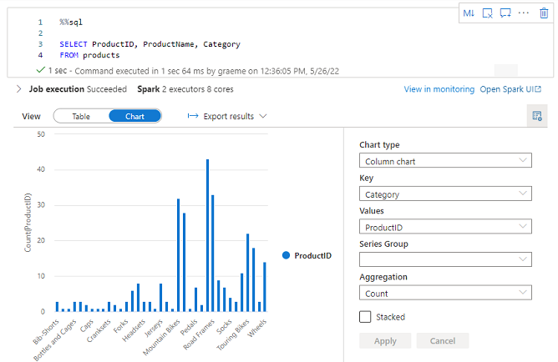
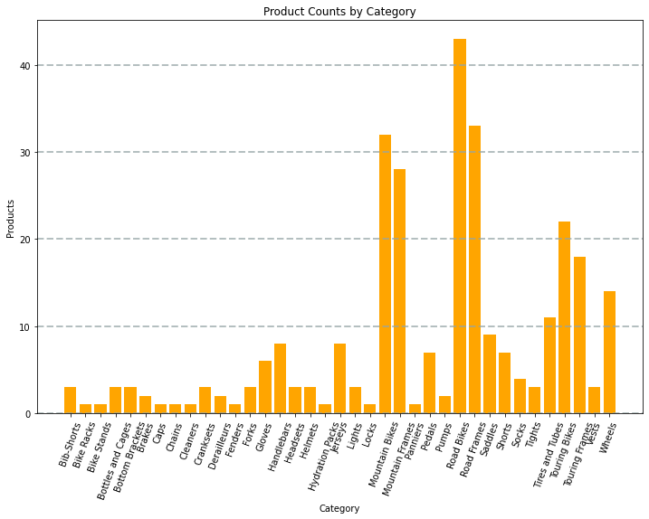
Visualize data with Spark
Built-in notebook charts
Graphics packages
from matplotlib import pyplot as plt
fig = plt.figure(figsize=(12,8))
plt.bar(x=data['Category'],
height=data['ProductCount'],
color='orange’)
plt.show()
Notes:
Emphasize that while notebooks do include charting capabilities, they’re designed to support ad-hoc data visualization when working interactively in the notebook. Most professional data analysts and scientists prefer the versatility of graphics libraries like Matplotlib or Seaborn to create charts and graphs for reports.

Slide 9

Demo: Analyze data with Spark
You can try this for yourself later by following the instructions at the link below:
https://aka.ms/mslearn-synapse-spark
Notes:
The demonstration will take around 45 minutes.
Tell students that they can try the steps for themselves after class, though they may need to use their own Azure subscription if a hosted environment is not provided.

Slide 10

Knowledge check
Which definition best describes Apache Spark?
A highly scalable relational database management system
A virtual server with a Python runtime
A distributed platform for parallel data processing using multiple languages
You need to use Spark to analyze data in a parquet file. What should you do?
Load the parquet file into a dataframe
Import the data into a table in a serverless SQL pool
Convert the data to CSV format
You want to write code in a notebook cell that uses a SQL query to retrieve data from a view in the Spark catalog. Which magic should you use?
%%spark
%%pyspark
%%sql
Notes:
Allow students a few minutes to think about the questions, and then use the animated slide to reveal the correct answers.

Slide 11
Transform data with Apache Spark in Azure Synapse Analytics

Slide 12
Modify and save dataframes
Load source file into a dataframe
Use dataframe methods and functions to transform the data:
Filter rows
Modify column values
Derive new columns
Drop columns
Write the modified data
Specify required file format
from pyspark.sql.functions import year, col
# Load data
df = spark.read.load("/data/orders.csv",
format="csv", header=True)
# Add Year column, derived from OrderDate
df = df.withColumn("Year", year(col("OrderDate")))
# Save transformed data
df.write.mode("overwrite").parquet("/data/orders.parquet")
Notes:
Point out that the code loads data in CSV format and saves the transformed results in Parquet format – sometimes that’s the only transformation required! In this case, the data is modified by adding a new column named “Year” that is derived from the OrderDate column by using the year function.
See the PySpark Dataframe API reference at https://spark.apache.org/docs/latest/api/python/reference/pyspark.sql/dataframe.html for more details of transformations you can apply to dataframes.

Slide 13


Partition data files
Partition data by one or more columns
Distributes data to improve performance and scalability
df.write.partitionBy("Year).mode("overwrite").parquet("/data")
data
Year=2020
Year=2021
Notes:
Partitioning data enables Spark to optimize query performance by distributing processing for each partition across worker nodes. Additionally, queries that filter based on partitioning columns improve performance by eliminating unnecessary disk IO.
Note that the folder names generated when partitioning a dataframe include the partitioning column name and value in a “column=value” format.

Slide 14
Transform data with SQL
Use the metastore to define tables and views
Use SQL to query and transform the data
Save transformed data as an external table
Dropping an external table does not delete the data files
# Create a view in the metastore
df.createOrReplaceTempView("sales_orders")
# Use SQL to transform data and return a dataframe
new_df = spark.sql("SELECT OrderNo, OrderDate, Year(OrderDate) As Year FROM sales_orders")
# Save the dataframe as an external table
new_df.write.partitionBy("Year").saveAsTable("transformed_orders", format="parquet",
mode="overwrite", path="/transformed_orders")
Notes:
Many data engineers are familiar with SQL syntax, and will find it easier to use when manipulating relational data structures. Creating a view in the metastore enables you to write SQL queries that return a transformed dataframe, which you can then write as an external table. External tables are relational tables in the metastore that reference files in a data lake location that you specify, so you can access the data by querying the table or by reading the files directly from the data lake. Additionally, external tables are “loosely bound” to the underlying data files – dropping the table does not delete the files, so you can use this technique to transform the data and persist it in files, drop the table, and still use the transformed data files in downstream processes.

Slide 15

Exercise: Transform data using Spark in Synapse Analytics
Use the hosted lab environment provided, or view the lab instructions at the link below:
https://aka.ms/mslearn-transform-spark
Notes:
The exercise will take a minimum of half an hour to complete, including 5-10 minutes at the start to set up the environment.
Not all students work at the same pace, so you should allow 45 minutes or more as necessary for your class.

Slide 16
Knowledge check
Which method of the Dataframe object is used to save a dataframe as a file?
toFile()
write()
save()
Which method is used to split the data across folders when saving a dataframe?
splitBy()
distributeBy()
partitionBy()
What happens if you drop an external table that is based on existing files?
An error – you must delete the files first
The table is dropped from the metastore but the files remain unaffected
The table is dropped from the metastore and the files are deleted
Notes:
Allow students a few minutes to think about the questions, and then use the animated slide to reveal the correct answers.

Slide 17
Use Delta Lake in Azure Synapse Analytics

Slide 18
What is Delta Lake?
Open-source storage layer that adds relational database semantics to Spark
Relational tables that support querying and data modification
Support for ACID transactions
Data versioning and time travel
Support for batch and streaming data
Standard formats and interoperability
Notes:
Note that you don’t need to use Delta Lake to manipulate or query data in Spark using SQL. You can create tables in the Hive metastore with data files in CSV or Parquet format and query them with SELECT statements. However, Delta Lake saves the data in Parquet format with additional metadata that enables tracking of transactions and versioning, providing an experience much more similar to a relational database system like SQL Server. Most new “data lakehouse” solutions built on Spark are based on Delta Lake, enabling you to combine the flexibility of file-based data lake storage with the transactional data integrity capabilities of a relational data warehouse.

Slide 19
Create Delta Lake tables
Create a Delta Lake table from a dataframe
df = spark.read.load("/data/mydata.csv", format="csv", header=True)
delta_table_path = "/delta/mydata"
df.write.format("delta").save(delta_table_path)
Make conditional updates
from delta.tables import *
from pyspark.sql.functions import *
deltaTable = DeltaTable.forPath(spark, delta_table_path)
deltaTable.update(
condition = "Category == 'Accessories'",
set = { "Price": "Price * 0.9" })
Query a previous version (time travel)
df = spark.read.format("delta").option("versionAsOf", 0).load(delta_table_path)
Notes:
Delta Lake tables are just like any other metastore tables except that the delta file format is used to save the data. This results in a folder sructure that not only contains the data files, but also metadata files that enable transactional functionality.
Note that to update a delta lake table using the API, you create a DeltaTable object based on the path where the data files are stored, and use its methods to perform data updates, inserts, and deletes.
The “Time Travel” feature of Delta Lake takes advantage of the metadata, which tracks transactions in the table. This enables you to retrieve and compare different versions of the same row based on the sequence of modifications made to the table or a given point in time.

Slide 20
Create catalog tables
Managed tables
Defined without a specific location – files are created in metastore folder
Dropping the table deletes the files
External tables
Defined with a specific file location
Dropping the table does not delete the files
df.write.format("delta").option("path","/mydata").saveAsTable("MyExternalTable")
spark.sql("CREATE TABLE MyExternalTable USING DELTA LOCATION '/mydata'")
%%sql
CREATE TABLE MyExternalTable
USING DELTA
LOCATION '/mydata'
Notes:
Catalog tables are how the metastore defines relational tables “on top of” file locations. They’re not unique to Delta Lake (you can create managed and external tables for Parquet and CSV formats too), but increasingly Delta Lake is the preferred way to build relational semantics into a data lakehouse solution on Spark.
Emphasize the key difference between managed and internal tables. Manages tables are stored in the default metastore file system location, and are “tightly bound” to the files – dropping the table deletes the files. External tables are based on files in a specified file system location, and dropping the table does not delete the files.

Slide 21
Use Delta Lake with streaming data
Use Delta Lake table as a streaming source
from pyspark.sql.types import *
from pyspark.sql.functions import *
stream_df = spark.readStream.format("delta") \
.option("ignoreChanges", "true") \
.load("/delta/internetorders")
stream_df.show()
Use Delta Lake table as a streaming sink
from pyspark.sql.types import *
from pyspark.sql.functions import *
stream_df = spark.readStream.schema(jsonSchema).option("maxFilesPerTrigger", 1).json(inputPath)
table_path = '/delta/devicetable'
checkpoint_path = '/delta/checkpoint'
delta_stream = stream_df.writeStream.format("delta").option("checkpointLocation", checkpoint_path).start(table_path)
Notes:
Spark Streaming is a complex subject in its own right, and we’re not going into it in great detail in this course. The key point is that Spark Structured Streaming provides a way to handle a stream of realtime data by using Dataframe semantics – essentially you can query a stream of data like a boundless dataframe that is perpetually receiving new data. Streaming support in Delta Lake builds on this by enabling you to treat a table as a source of streaming data for a Spark Structured Streaming dataframe, or as a sink (target) to which a Spark Structured Streaming dataframe writes its data.

Slide 22
Use Delta Lake in a SQL pool
Query delta table files using OPENROWSET
SELECT *
FROM
OPENROWSET(
BULK 'https://mystore.dfs.core.windows.net/files/delta/mytable/',
FORMAT = 'DELTA'
) AS deltadata
Query delta tables in Spark metastore databases
USE default;
SELECT * FROM MyDeltaTable;
Notes:
Until now, we’ve focused on working with Delta Lake tables using Spark. In Azure Synapse Analytics, you can also work with Delta Lake tables using SQL in a SQL pool.
Note that you can use the OPENROWSET function to load data from a Delta Lake table folder location by specifying DELTA format.
You can also use native SQL SELECT statements to query Delta Lake tables in the Spark metastore. By default, metastore tables are defined in a database named default; but you can create additional databases in the metastore just as you can in SQL Server and query the tables they contain by using the specific database name.

Slide 23
Exercise: Use Delta Lake in Azure Synapse Analytics
Use the hosted lab environment provided, or view the lab instructions at the link below:
https://aka.ms/mslearn-delta-lake
Notes:
The exercise will take a minimum of forty minutes to complete, including 5-10 minutes at the start to set up the environment.
Not all students work at the same pace, so you should allow an hour or more as necessary for your class.

Slide 24
Knowledge check
Which of the following descriptions best fits Delta Lake?
A Spark API for exporting data from a relational database into CSV files
A relational storage layer for Spark that supports tables based on Parquet files
A synchronization solution that replicates data between SQL pools and Spark pools
You've loaded a Spark dataframe with data, that you now want to use in a Delta Lake table. What format should you use to write the dataframe to storage?
CSV
PARQUET
DELTA
What feature of Delta Lake enables you to retrieve data from previous versions of a table?
Spark Structured Streaming
Time Travel
Catalog Tables
Notes:
Allow students a few minutes to think about the questions, and then use the animated slide to reveal the correct answers.

Slide 25

Further reading
Perform data engineering with Azure Synapse Apache Spark Pools
https://aka.ms/mslearn-spark
Notes:
Encourage students to review the online material on Microsoft Learn on which this presentation is based.

